Slide 1
PowerShell Calculator Incorporating NPV Concept
Name: Sumit Pal
HID: H10006112
AID: A00223120
Semester: 1
Subject: Management Scripting: CMP1006
Description: Lab Week 4
Prof. Vivek Ahuja

Slide 2
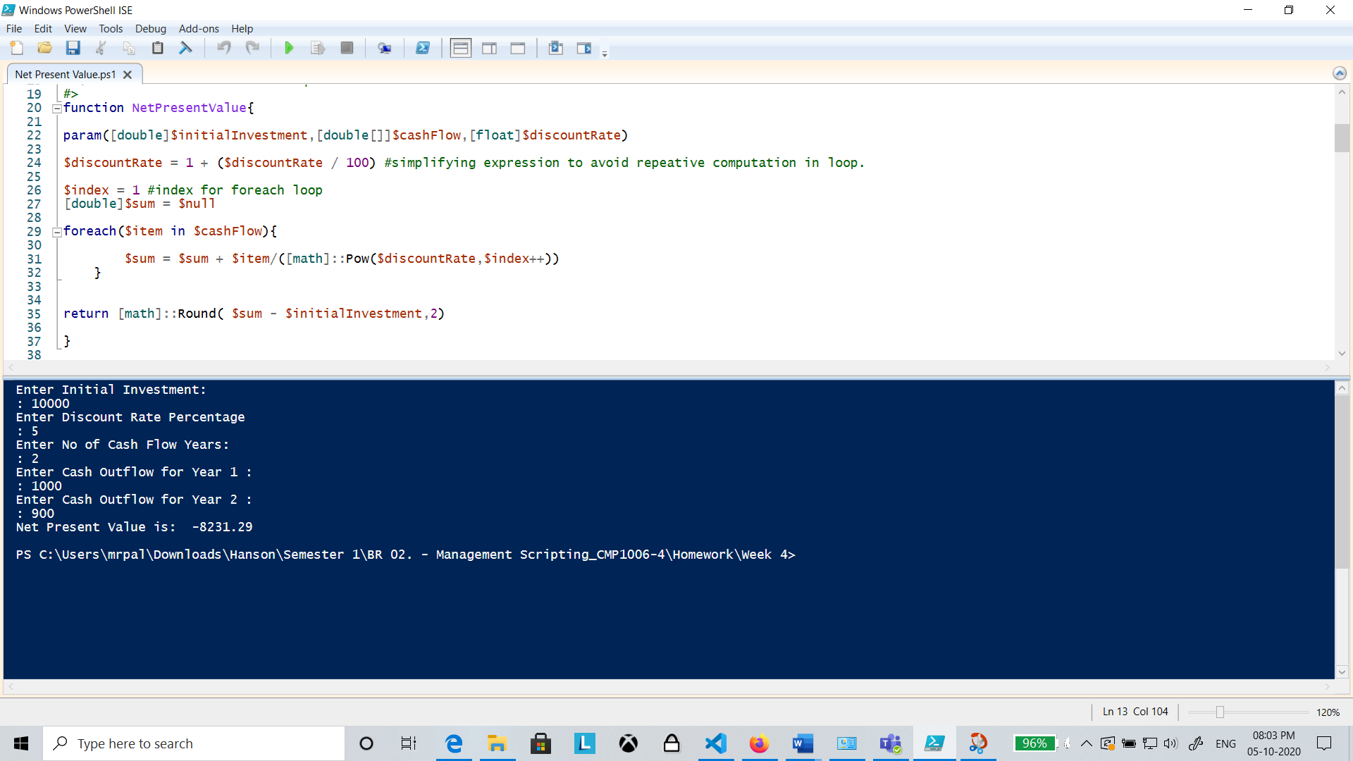
Script Output Screenshot

Slide 3
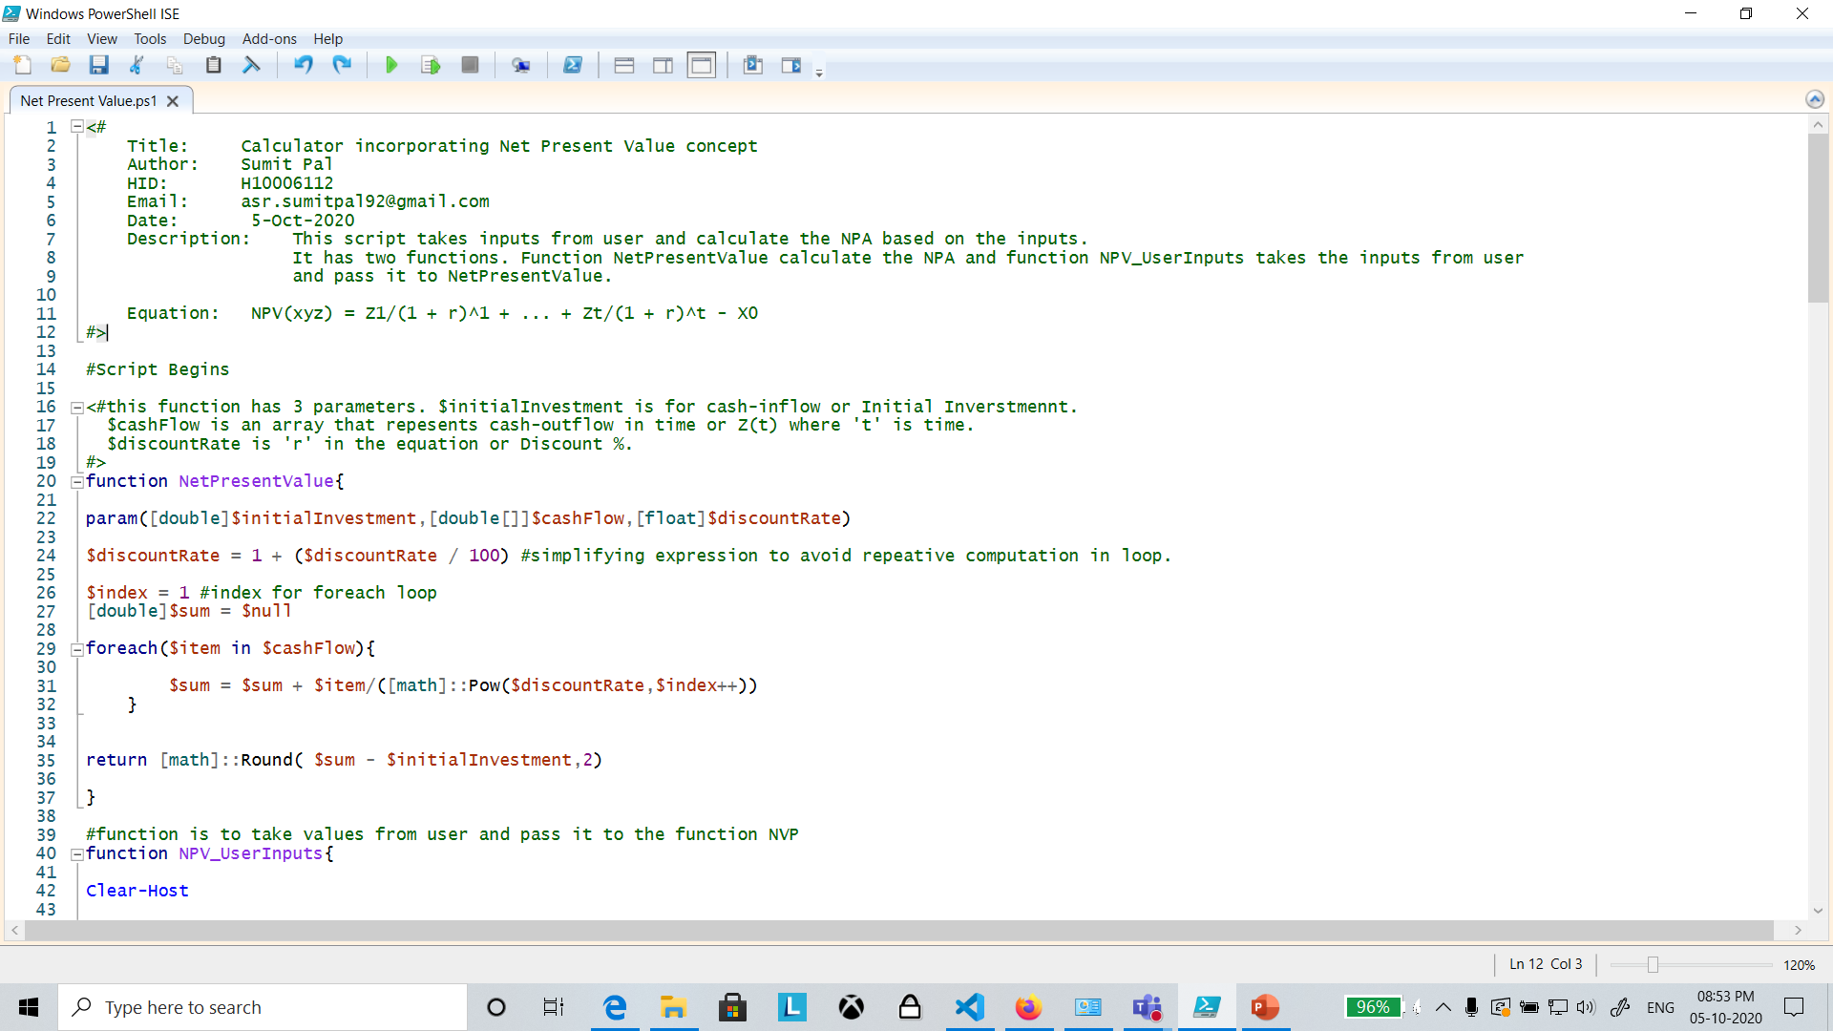

Slide 4
